Slide 1
Climate Change, part 1
September 8, 2021

Slide 2
Temperature responds to various “forces”
We can generalize the idea of a ”force” to include anything that leads to a change in temperature.
Because temperature is a measure of energy, the temperature will increase when there is deviation from the flow of energy in equilibrium.
If the total flow of energy into a system is greater than the total flow of energy out of a system then it must store that energy internally. If there are no phase changes, then that must produce a change in temperature.
SYSTEM
Sources of energy
Sinks
of energy

Slide 3
Solar irradiance balance
In the simplest model of climate, the sun provides a power input and the earth re-radiates that power back into space as long-wavelength IR radiation.
$$P_{Sun}=P_{Earth IR radiation}$$
Must consider this problem in some average sense:
at least averaged over a day
Averaging over the yearly seasonal cycle may make sense
We’ll ignore those details for now and assume that the energy input from the sun gets “well mixed” around the Earth to create a uniform situation.

Slide 4
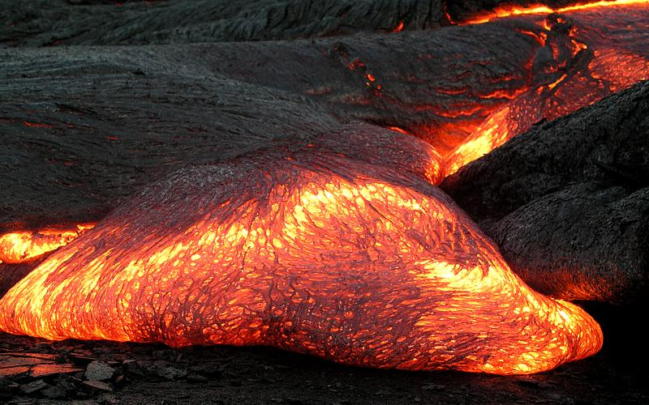
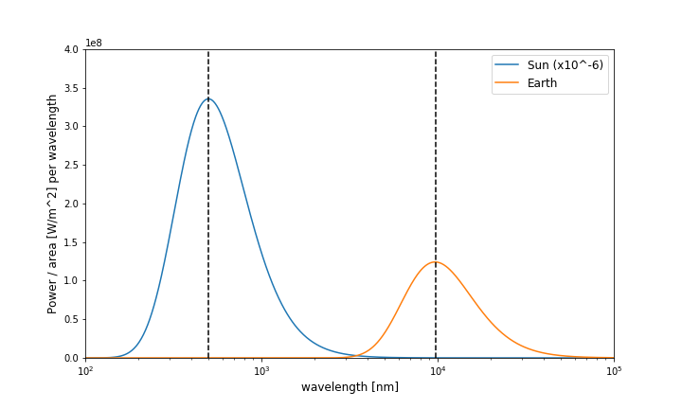
Blackbody radiation
Any body at a non-zero temperature will emit electromagnetic radiation (light) in a way that depends on the temperature of the body.
The Planck law of radiation [in units of Power/Area per wavelength]:
$$P_{λ}\left(λ,T\right)=\frac{8πhc^{2}}{λ^{5}}\frac{1}{e^{{hc}/{λkT}}−1}$$
T_{Sun} ~ 5800 K T_{Earth} ~ 300 K
Notes:
As objects heat up they become much brighter (lots more radiation!)

Slide 5
BlackBody Radiation
Integrated over all wavelengths, we find the following relationship
$P_{A}\left(T\right)=σT^{4}$ Stefan-Boltzmann equation
𝝈 = 5.67 x 10⁻⁸ W / m² K⁴
T in units of Kelvin [K]
Total radiated power depends on the size of the object.

Slide 6
BlackBody Radiation of the SUN
Measurements indicate that the incident power from the Sun at Earth is P_{A}=1368 W/m².
Can we derive this number?

Slide 7
BlackBody Radiation of the SUN
Measurements indicate that the incident power from the Sun at Earth is 1368 W/m².
Can we derive this number? Yes! We use $P_{A}\left(T\right)=σT^{4}$ [W / m²]
Radius of the sun is R_{Sun} ~ 7.0 x 10⁸ m, and total surface area is $A_{sun}=4πR_{Sun}^{2}$.
The total radiated power is $P_{tot}=P_{A}∗A_{sun}≈$ 4.3 x 10²⁷ W.
But at the Earth we have lower power flux (larger area). Dividing by the area of the sphere formed by the Sun-Earth radius (R_{S-E} ≈1.5 x 10¹¹ m) we get
$P_{A}^{E}=\frac{P_{tot}}{4πR_{S−E}^{2}}≈1400$ W / m²

Slide 8
BlackBody Temperature of Earth
The power flux in is about 1350 W / m².
Not all of the incident radiation is absorbed, some is reflected. We must define a parameter that describes how ”reflective” an object is.
Albedo (a): normalized reflectivity of an object, 0 < a < 1.
For current Earth conditions, we believe that a ≈ 0.3 (so 70% of the power is absorbed).

Slide 9
BlackBody Temperature of Earth
Earth absorbs energy from the Sun based on its cross-sectional area:
$$P_{in}=\left(1−a\right) P_{A}^{E}∗πR_{E}^{2}$$
where the radius of the Earth is R_{E} ≈6.4 x 10⁶ m.

Slide 10
BlackBody Temperature of Earth
Earth absorbs energy from the Sun based on its cross-sectional area:
$$P_{in}=\left(1−a\right) P_{A}^{E}∗πR_{E}^{2}$$
where the radius of the Earth is R_{E} ≈6.4 x 10⁶ m.
The Earth radiates as a spherical object so that
$$P_{out}= σ{ T}_{E}^{4}∗4πR_{E}^{2}$$

Slide 11
BlackBody Temperature of Earth
Putting these equations together using P_{in} = P_{out} gives:
$$\left(1−a\right) P_{A}^{E}∗πR_{E}^{2}=σ{ T}_{E}^{4}∗4πR_{E}^{2}$$
where the only unknown now is the temperature of Earth.
Solving for T_{E}, we find:
$T_{E}={\left[\frac{\frac{1}{4}{ \left(1−a\right) P}_{A}^{E}}{σ}\right]}^{1/4}≈$ 255 K (-20 ºC or -4 ºF)

