Slide 1
Earth’s PaleoClimate
September 1, 2021

Slide 2
Earth’s Climate has Warmed and Cooled many times
Over long geologic history, there have been many variations in earth’s climate, with very warm and very cold periods:

Slide 3
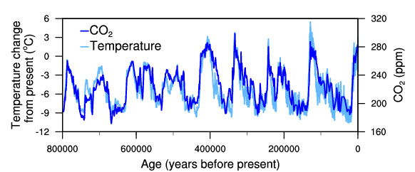
The connection between Temperature and CO₂ levels
Over long geologic history, there have been many variations in earth’s climate, with very warm and very cold periods:
Jouzel et al., NOAA report (2007) https://www.ncdc.noaa.gov/paleo-search/study/6080
Notes:
About a 100 year lag between temperature and CO2, with CO2 lagging behind temperature

Slide 4
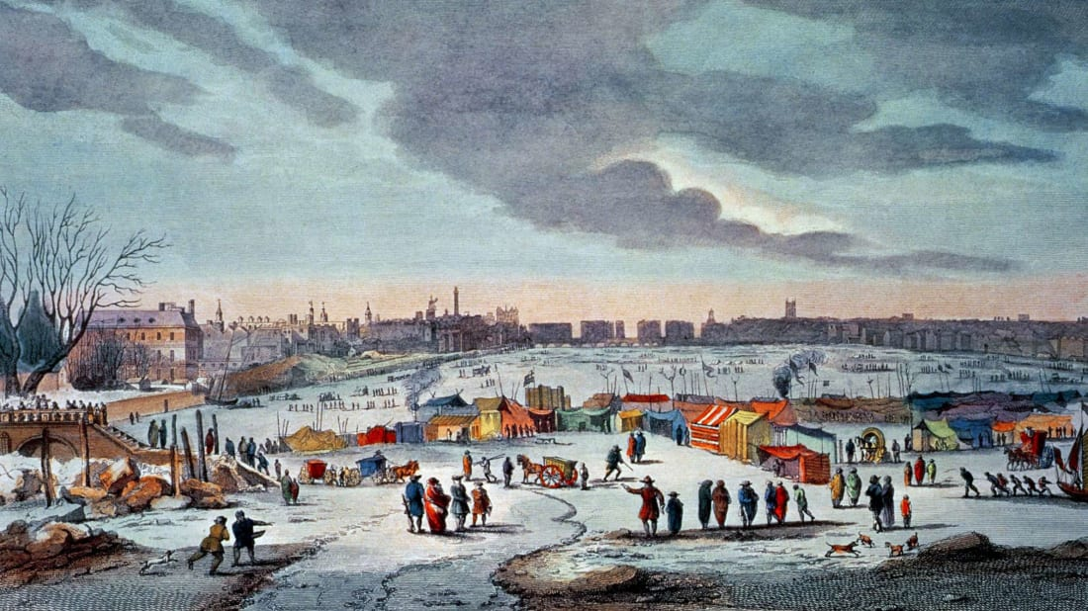
Global temperature changes in recent history
Little ice age in Europe (approximately 1300 – 1900 AD)
The Thames and parts of the North Sea were frozen solid in winter of 1683-84
Similar incidents were recorded regularly throughout this period
Few such incidents have been noted in the 19th and 20th century.
The Thames last freeze was 1963
Painting of a “Frost Fair” on the Thames in London, by Thomas Wyke (c. 1683-1684)

Slide 5
Global temperature changes in recent history
Little ice age in Europe (approximately 1300 – 1900 AD)

