Slide 1
Building Energy Overview

Slide 2
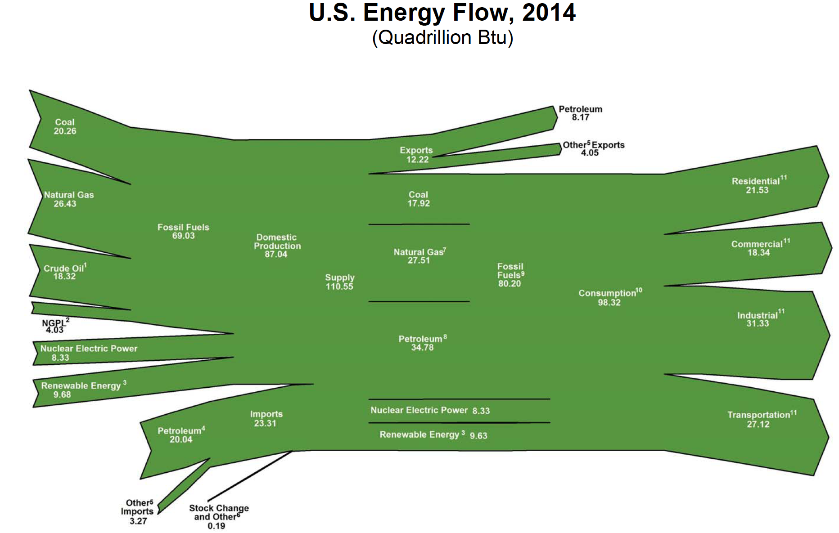

Slide 3
How Much is 100 quads?

Slide 5
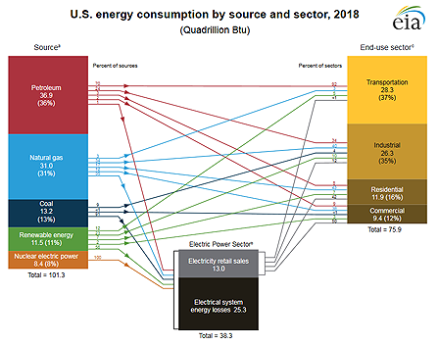

Slide 6
Current Use and Projections (quads)

Slide 7
Current Use and Projections
Delivered energy consumption in residential sector is projected to decrease by 15% by 2040 due to improvements in the efficiency of household appliances and heating systems and improvements in the envelope
To achieve the 80% GHG reductions called for in New York, housing energy use needs to be reduced by 35% to 60% over current levels

Slide 8
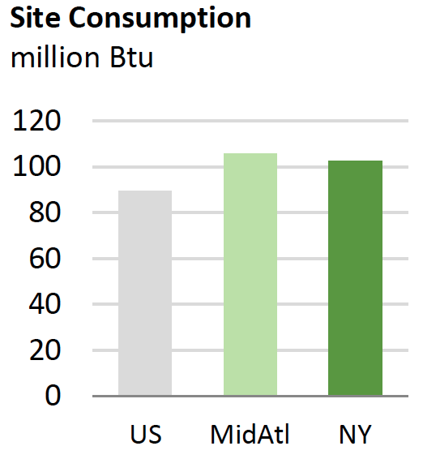
Current Use and Projections

Slide 9
Current Use and Projections

Slide 10
Current Use and Projections

Slide 11
Electricity in New York

Slide 12
Direct CO2 Emissions (million MT)

Slide 13
Projections for Direct CO2 Emissions
Direct CO2 emissions from the residential sector are projected to decrease by 19% by 2040 due to improvements in building efficiency and greening of the electricity grid
This can be compared to the 80% GHG reductions called for in New York which which is already unlikely to be sufficient

Slide 14
Opportunities for Efficiency Improvements Abound

Slide 15
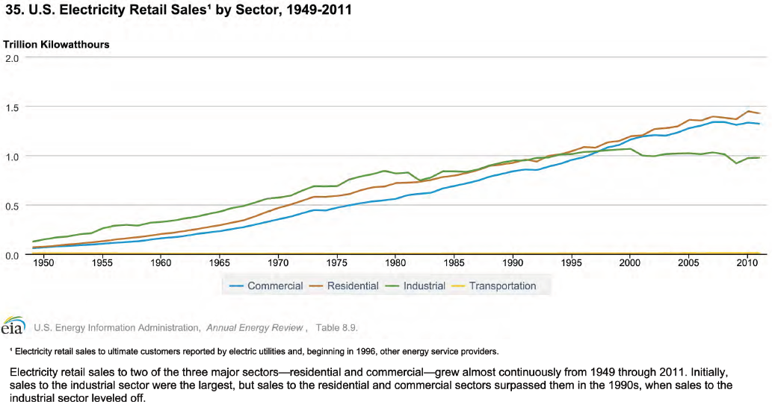

Slide 16
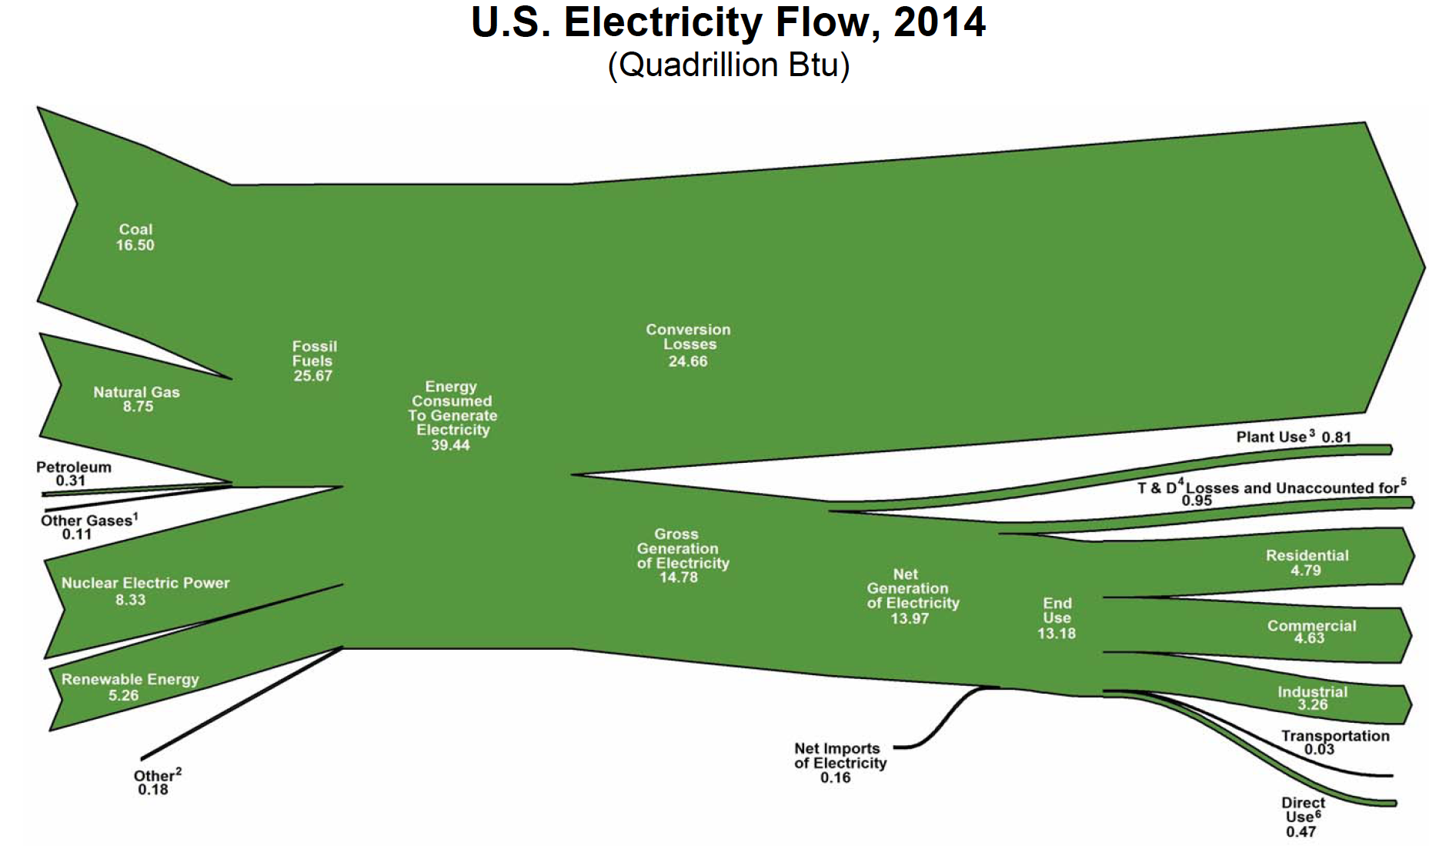

Slide 17
Current Use and Projections

Slide 18
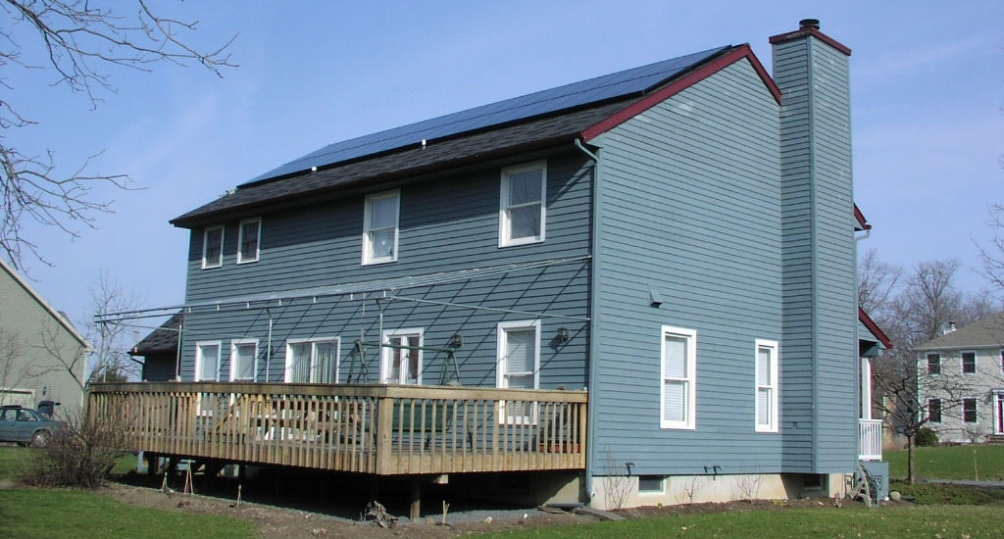
Opportunities for Efficiency Improvements Abound

Slide 19
Opportunities for Efficiency Improvements Abound

Slide 20
Opportunities for Efficiency Improvements Abound

Slide 21
We Will Focus in this Class on Space and Water Heating

Slide 22
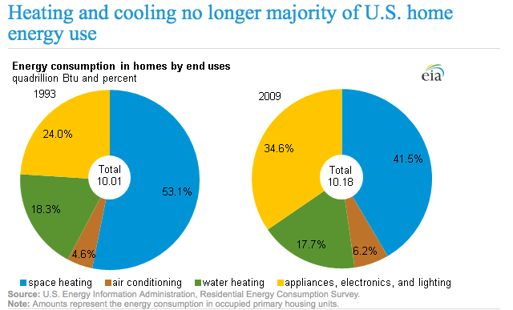
How Energy is Used in the Home

Slide 23
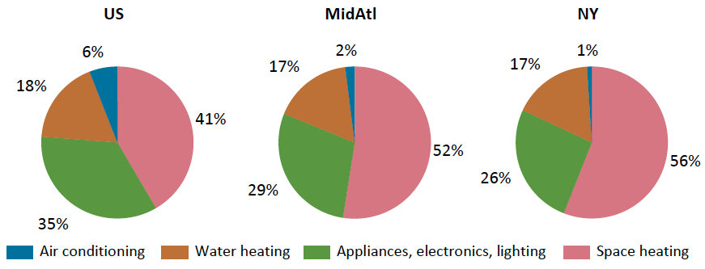
How Energy is Used in the Home

Slide 24
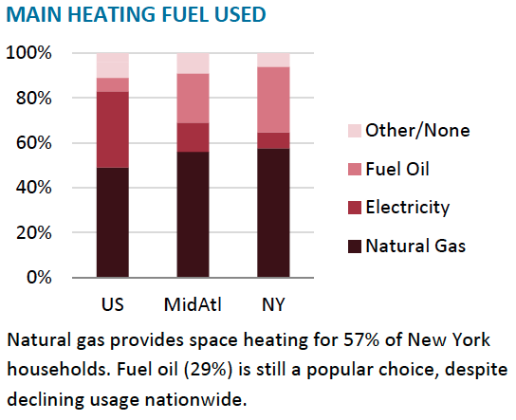
How Energy is Used in the Home

Slide 25
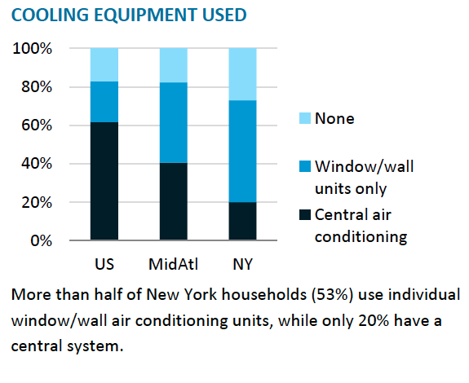
How Energy is Used in the Home

Slide 26
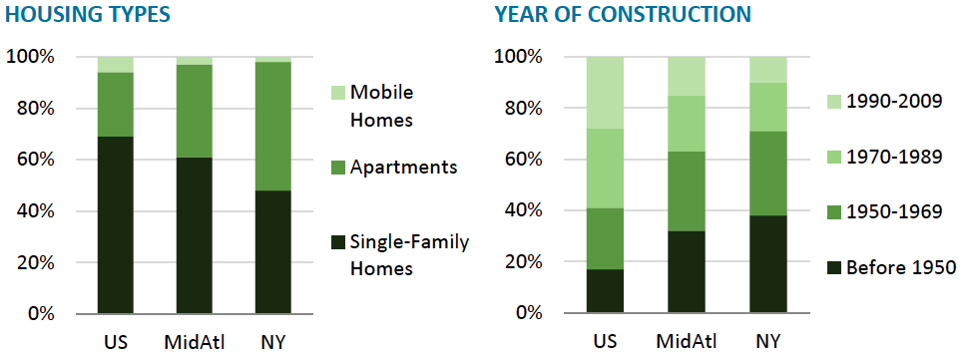
When Looking at Data for New York Don’t Forget about “the City”

Slide 27
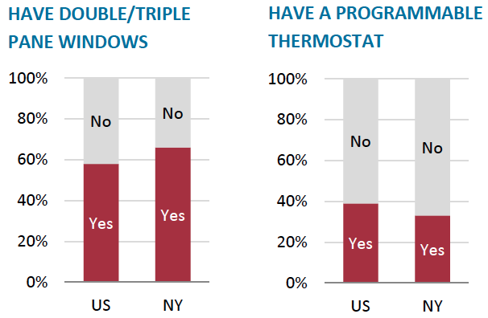
Despite Cold Climate NY is Not Far Ahead in Higher Efficiency Heating Systems

Slide 28
How Energy is “Lost” / Wasted in the Home

Slide 29
How Energy is “Lost” in the Home Improper or Inadequate Insulation

Slide 30
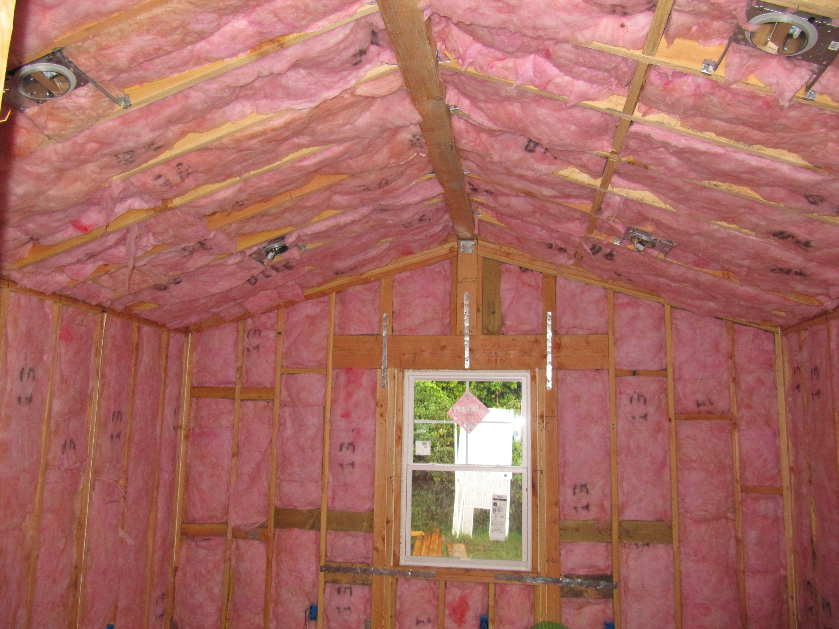

Slide 31
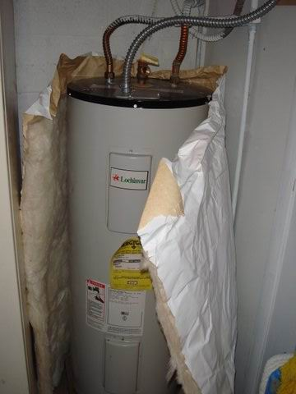
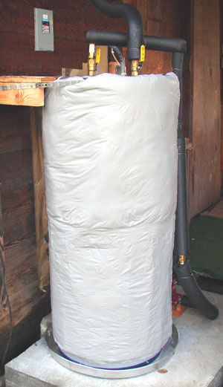

Slide 32
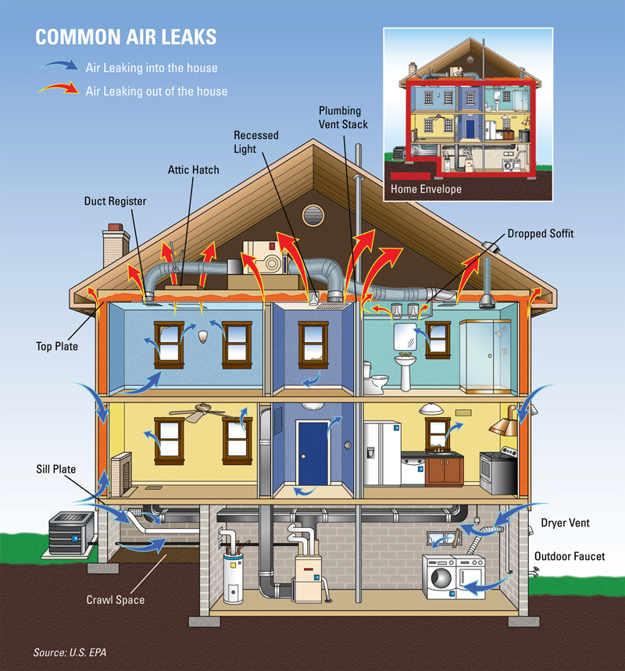

Slide 35
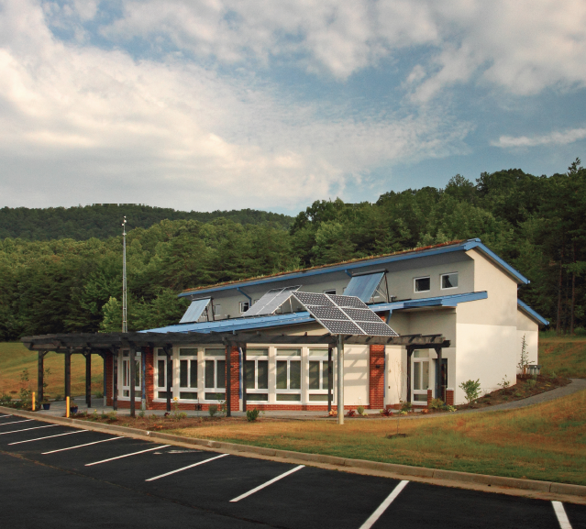
The Center for Energy Efficient Design (CEED)
Located in Franklin County, Va.
Built in 2009-10
The first US public school designed to the Passivhaus building standard.
Cost premium of 3.1% with 7 year payback
Annual energy savings = $3,450

Slide 36
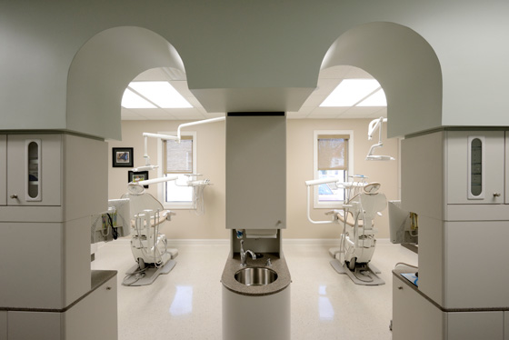
Family Run Dental Clinic
Located in Roanoke, Va.
5,400 sq ft built in 2011-13
Built for $155 / ft² compared to typical conventional dental clinic costs of $150 to $200 / ft²
Uses 70% less energy than conventional construction
Annual energy savings of $9,300

Slide 37
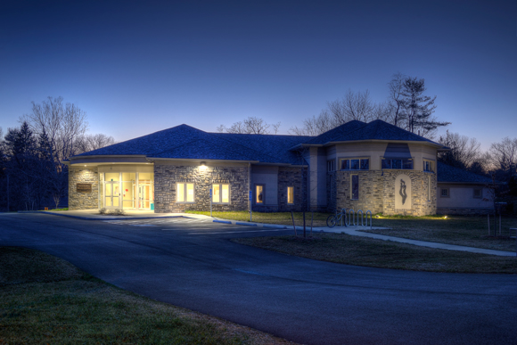
Malcolm Rosenberg Hillel Center for Jewish Life
Located in Blackburg, Va across from Virginia Tech
8,000 sq ft built in 2011-13
First Passivhaus building with commercial kitchen inside
Built for $135 / ft²
Uses 60% less energy than conventional construction

Slide 38
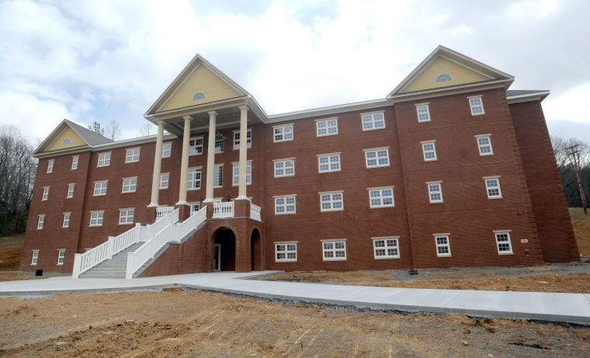
Hickory Hall - Emory & Henry College
Located in Emory, Va.
Built in 2012-13
Largest Passivhaus building in US.
Uses 62% less energy than its twin Elm Hall which is LEED certified and 74% less than code
Employs GSHPs and energy recovery vehicles
Reduced installed cooling capacity from 68 tons in Elm Hall to 14 tons and reduced heating capacity from 68 tons to 12 tons even though it is 11% larger than Elm Hall

Slide 39
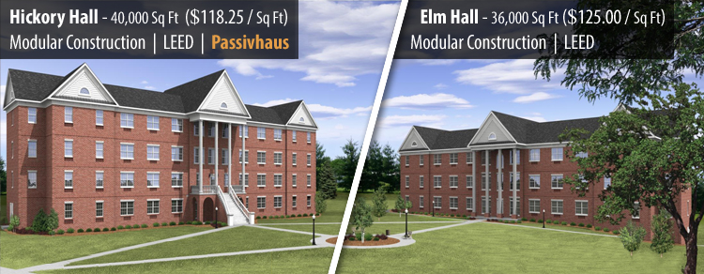
Hickory Hall - Emory & Henry College
Hickory Hall (40,000 sq ft and 117 beds) = $118.25 / ft²
Completed in 2013
Elm Hall (36,000 sq ft and 116 beds) = $125 / ft²
Completed in 2010

Slide 40
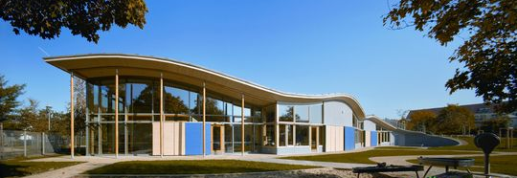
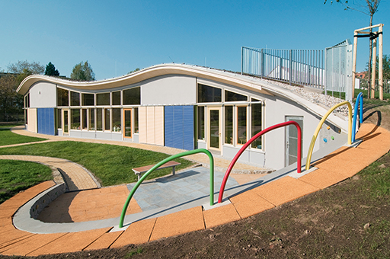
Passivehaus Kindergarten in Germany

Slide 41
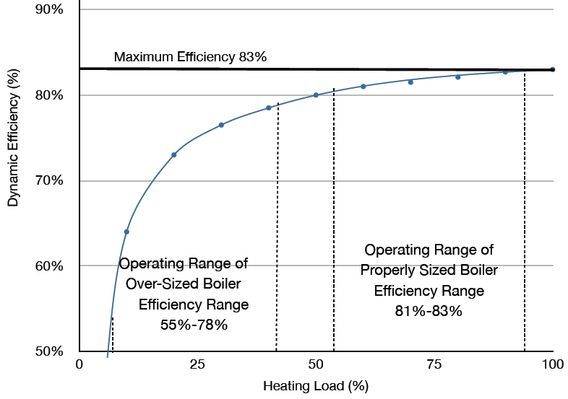
Oversized Boilers and Furnaces

Slide 42
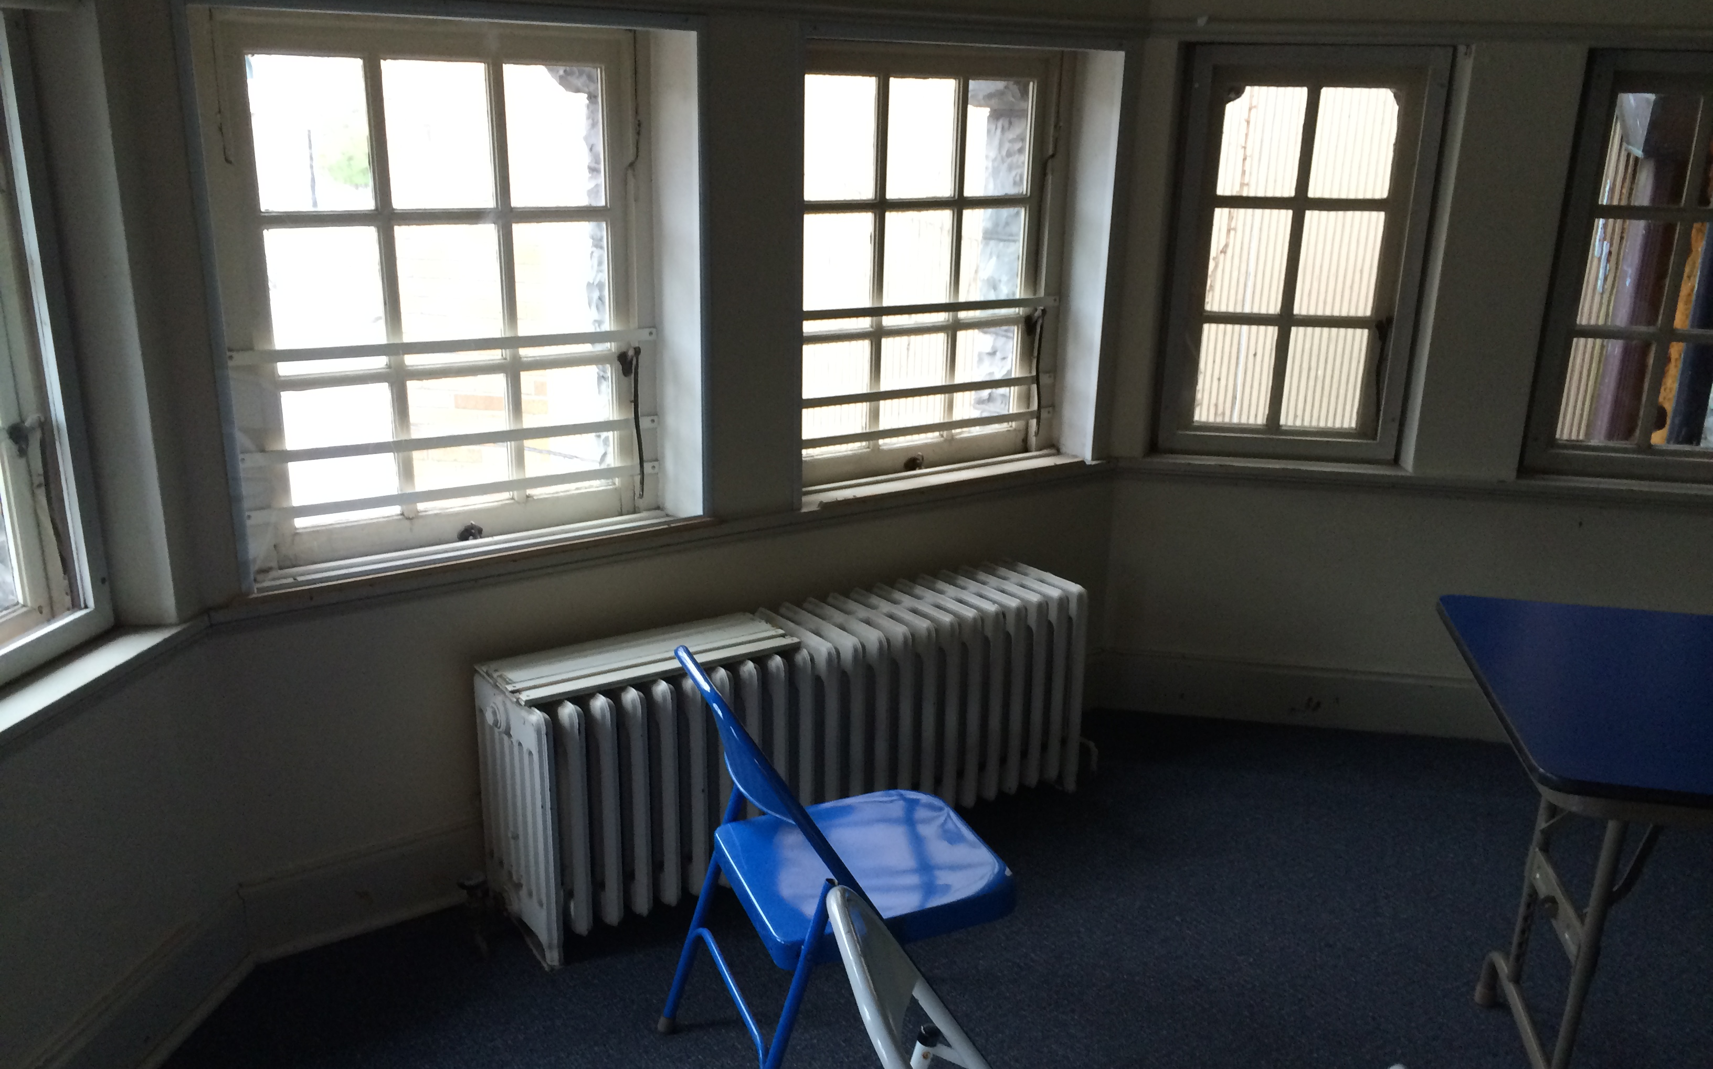
Outdated Distribution Systems

Slide 43
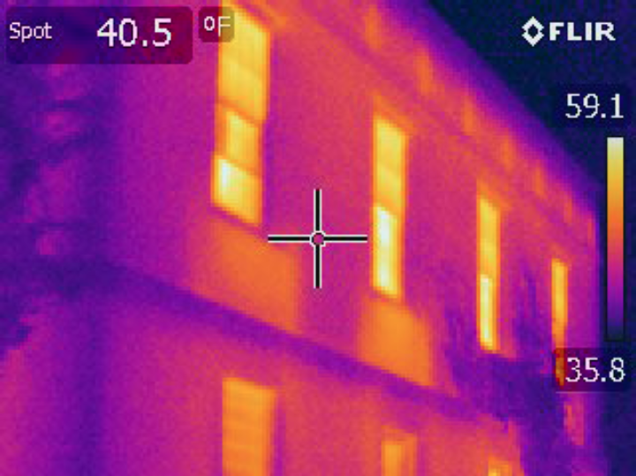

Slide 44
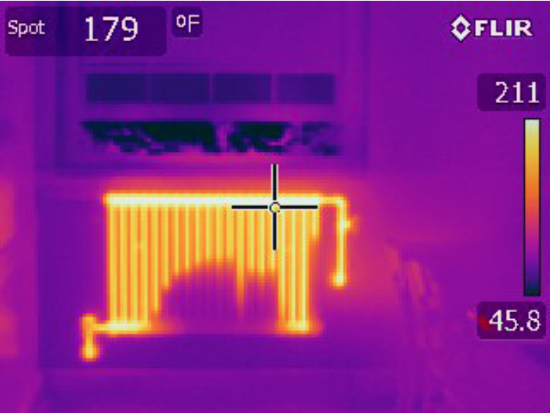

Slide 45
High Efficiency Heating

Slide 46
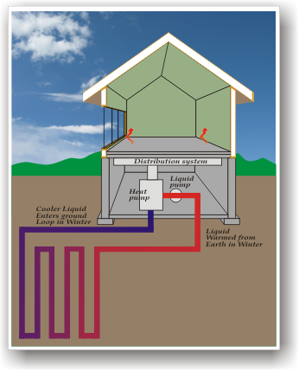
Ground Source Heat Pumps (GSHP)
Uses familiar refrigeration technology
Super efficient way to use electricity for 100% of building heating and cooling for all size buildings
Efficiencies of up to 300% by extracting heat from the ground
Notes:
No shortage electricity supply
Heat produced at normal building heating temperatures

Slide 47
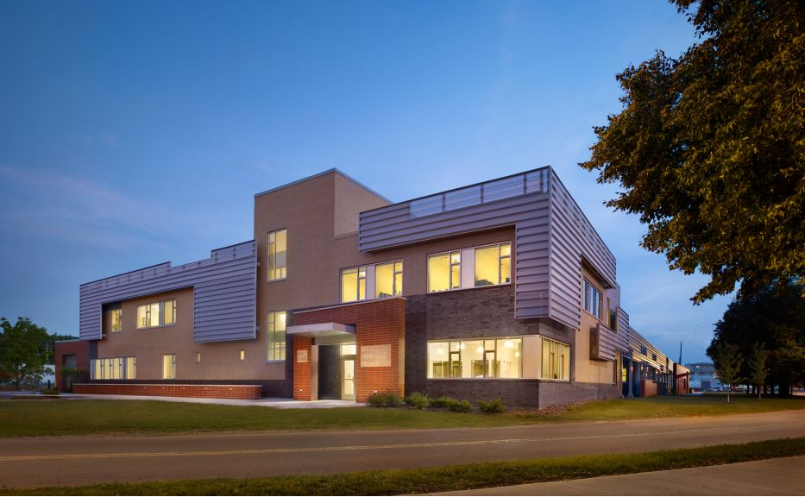
Professional Studies Building SUNY Cortland

Slide 48
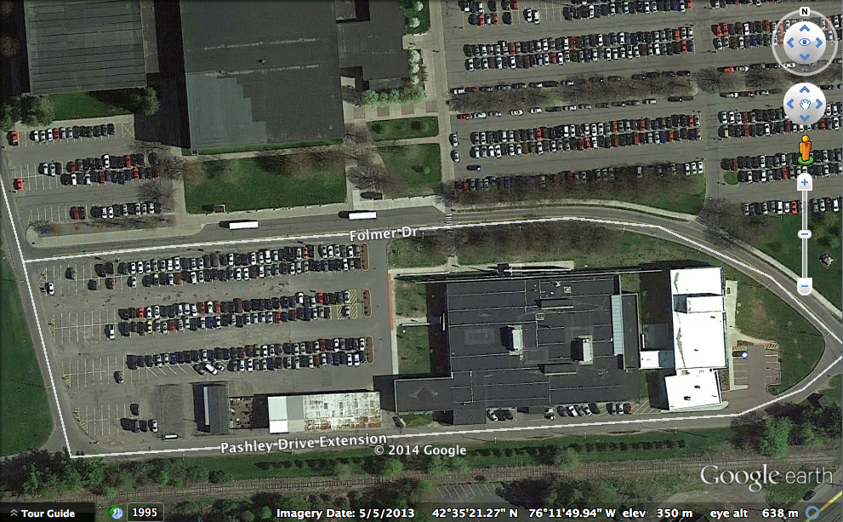
Professional Studies Building 40 wells and approximately 35 tons of capacity
Notes:
These wells contain roughly 35 gallons of glycol in total

Slide 49
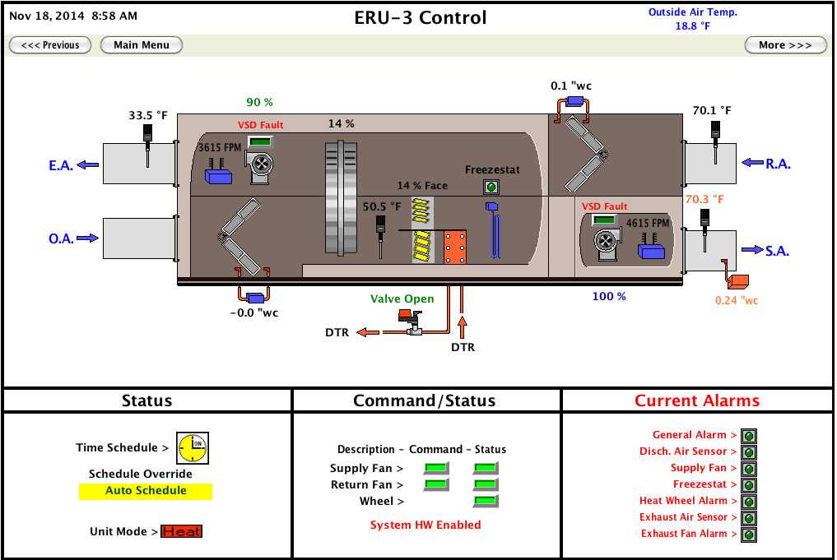
Professional Studies Building – Heat Pump

Slide 50
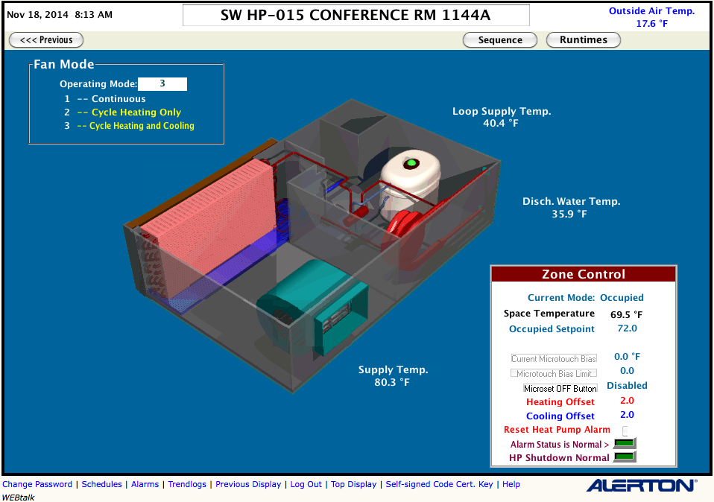
Professional Studies Building – Heat Pump

Slide 51
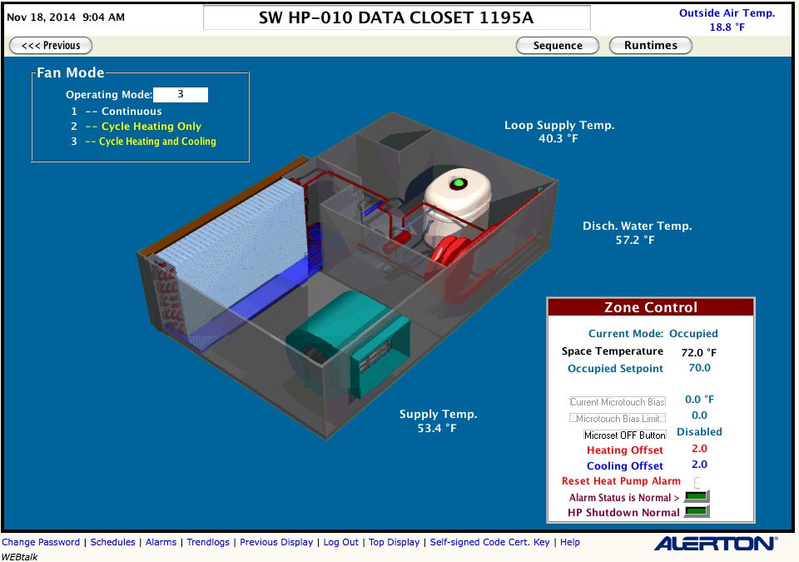
Professional Studies Building – Heat Pump

Slide 52
Air Source Heat Pumps (ASHP)
Same refrigeration technology as ground source heat pumps
Efficiencies of up to 200% by extracting heat from the air
Remain operational to air temperatures as low as -13 ºF
Notes:
% efficiency comparison

Slide 53
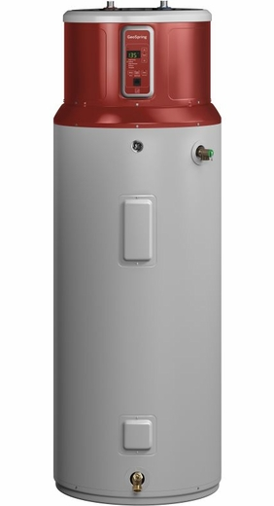
Air Source Heat Pumps for DHW
Efficiencies of up to 150-200% by extracting heat from the air
Provide supplemental dehumidification if located in basement
More complex to consider if they have to be located within the thermal envelope
Notes:
% efficiency comparison

Slide 54
When Electrifying the Heating System we Need to Consider the Source of the Electricity

Slide 55
Electricity in New York

Slide 56
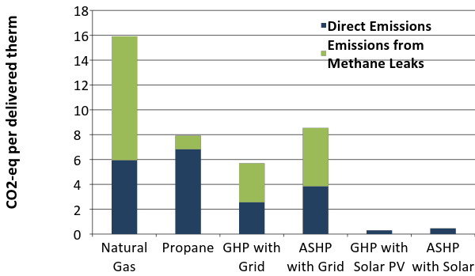
Greenhouse Gas Emissions from Heating
Greenhouse gas emissions reduced by 45 to 65 % if using heat pumps powered by grid electricity

Slide 57
Greenhouse Gas Emissions from Heating
Greenhouse gas emissions reduced by more than 97 % if using heat pumps powered by solar PV

