Slide 1
NEC and Ampacity

Slide 2
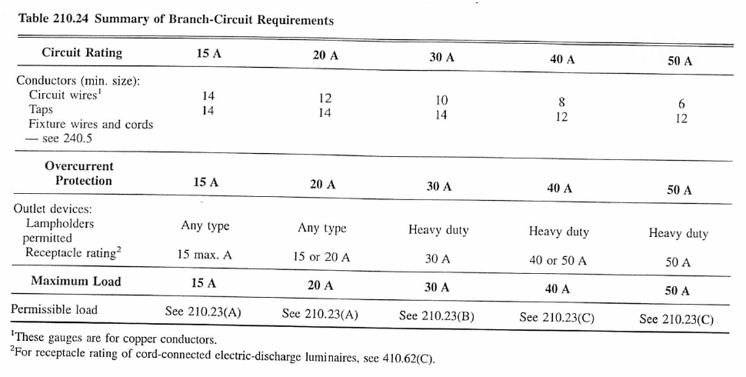
Ampacity
Finding wire gauge necessary, depends on situation.
Minimum is set by table 210.24:

Slide 3
Detailed calc comes starts with either Table 310.15(B)(16) for <=3 current carrying wires in a raceway or 310.15(B)(17) for 1 wire. In practice you will care about THHN, THWN, or USE2.

Slide 4
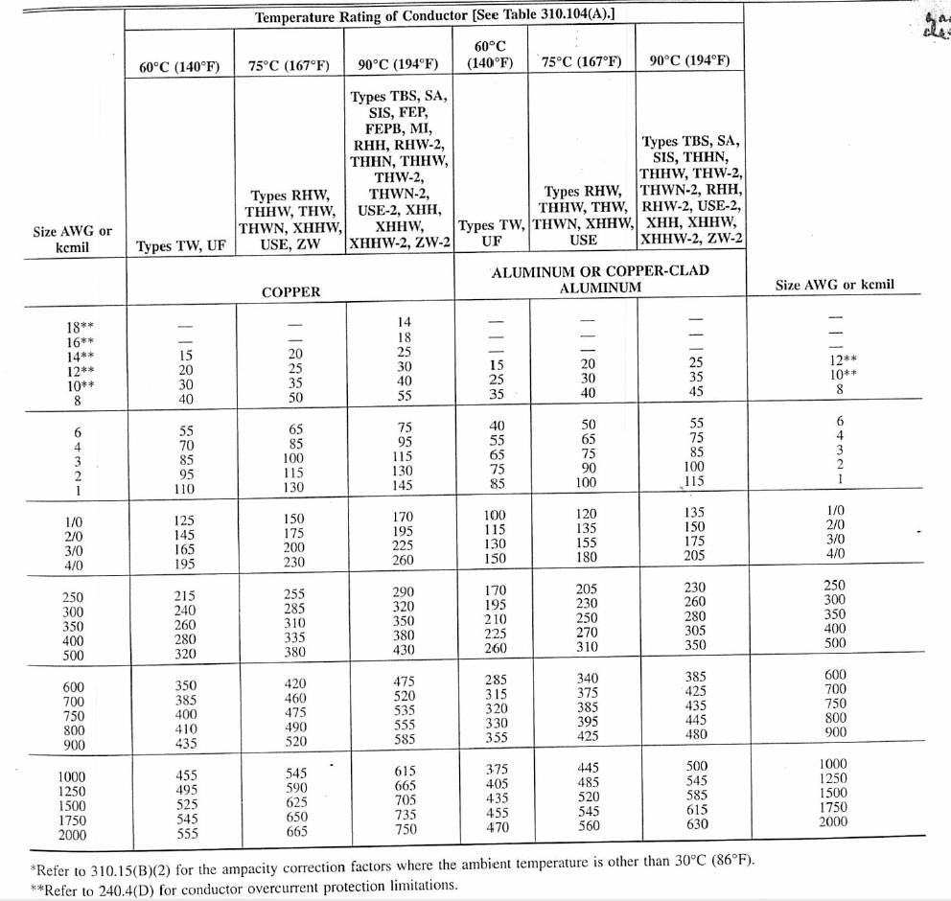
310.15 (B)(16) for <=3 current carrying wires

Slide 5
310.15 (B)(17) for 1 current carrying wire

Slide 6
This is mediated by temperature [from 310.15(B)(2)(a)]

Slide 7
Number of conductors in a raceway [from Table 310.15(B)(3)a)]

Slide 8
Raceway packing [chapter 9 table 1]

Slide 9
Raceways-Insulated conductors sizes [Chapter 9 table 5]

