Slide 1
Regulatory overview for PV systems

Slide 2
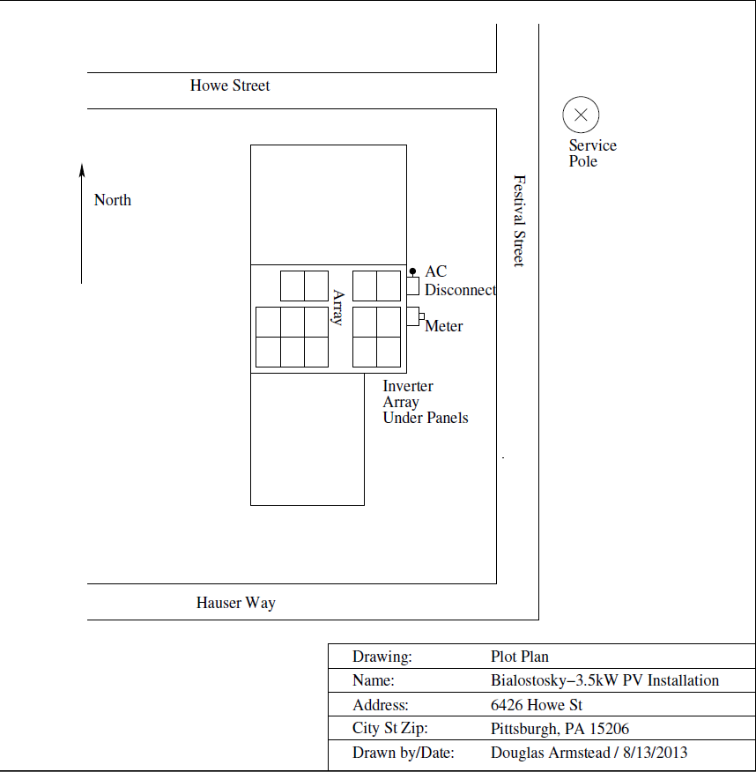
Plot Plan Example
(Accepted by utility rejected by zoning board)

Slide 3
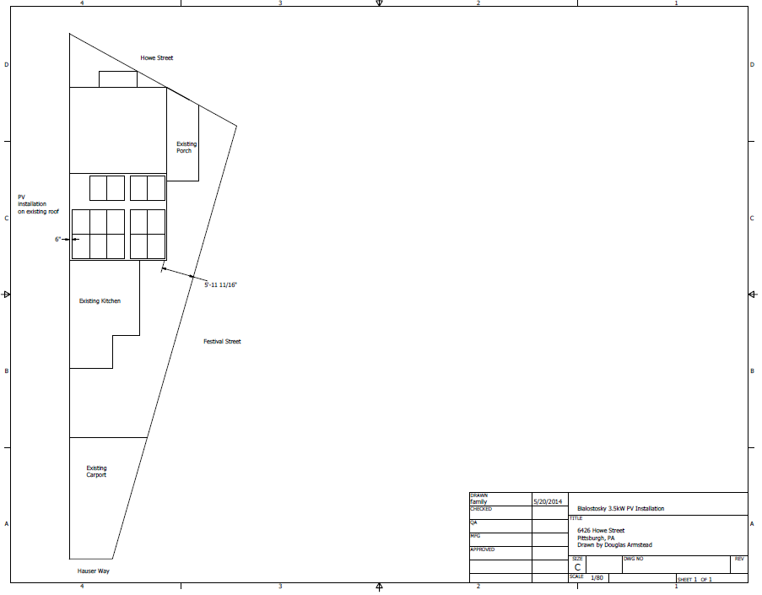
Plot Plan Example
(Accepted by zoning board)

Slide 4
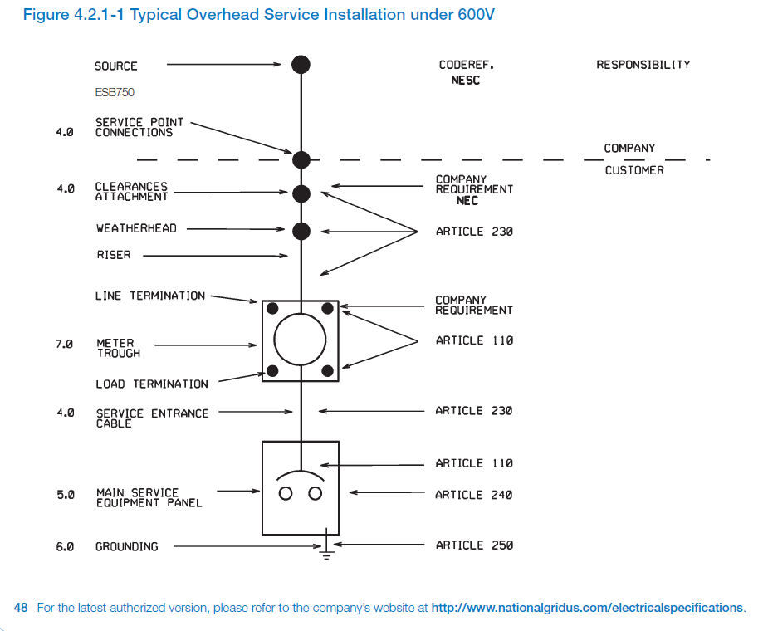
One Line Diagram
(Service Installation National Grid)

Slide 5
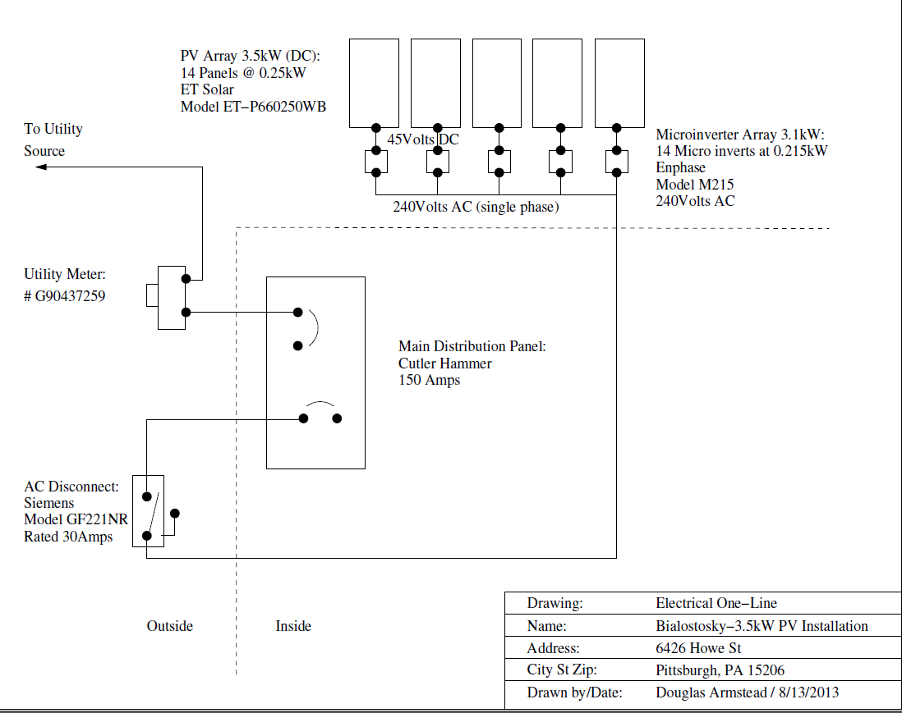
One Line Diagram
(Micro Inverters)

Slide 6
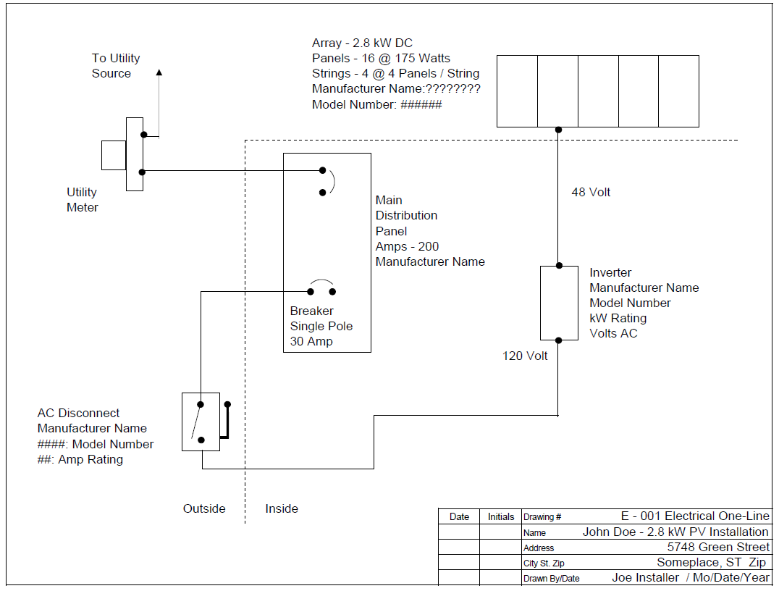
One Line Central Inverter

Slide 7
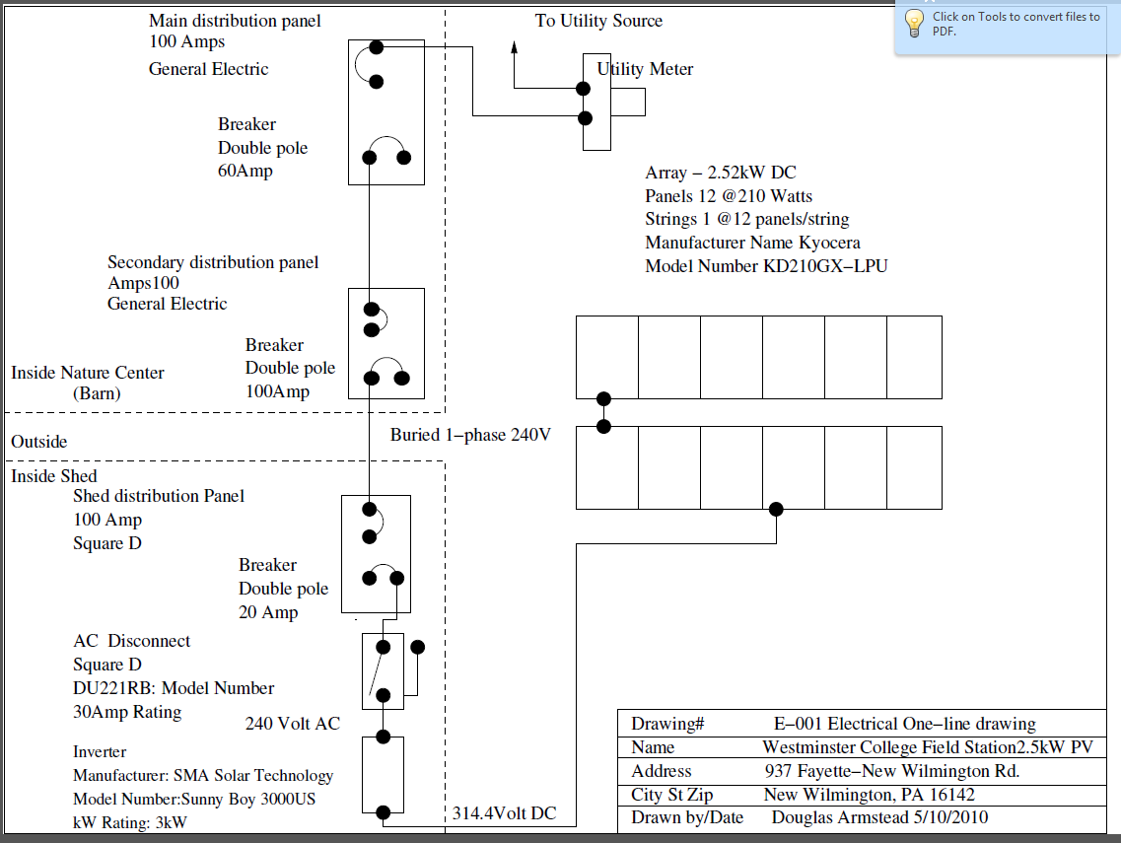
One Line complex layout

Slide 8
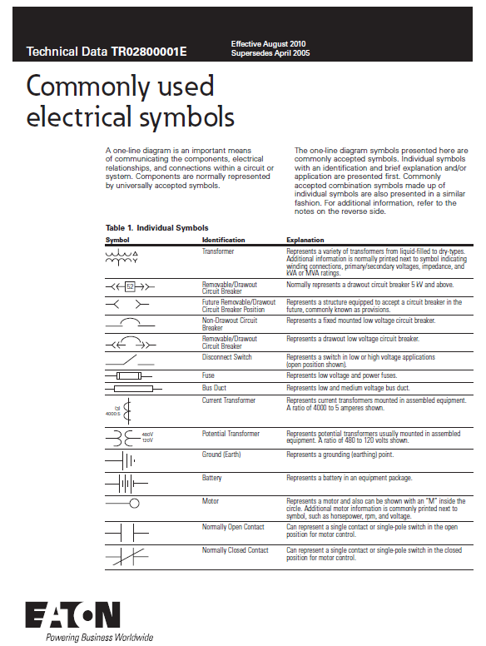
Common one-line diagram symbols

Slide 9
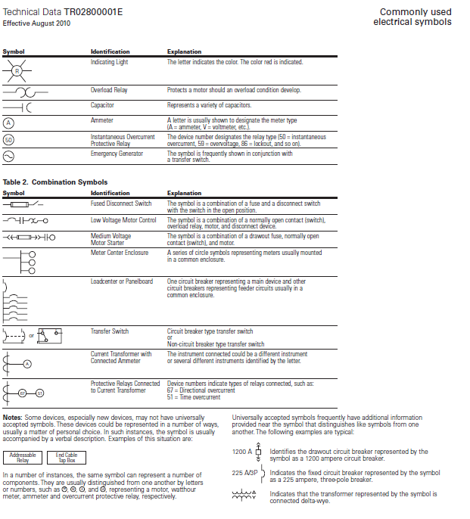
Common one-line symbols cont.

Slide 10
One Line Diagram
(Micro Inverters)

Slide 11
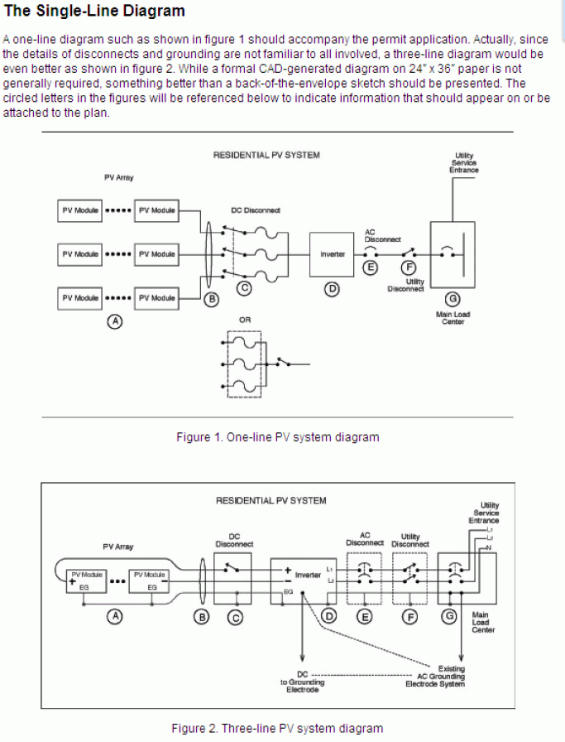
One-Line vs Three-Line
(show +, -, L1, L2, N, and EG)

Slide 12
Application Examples
http://facultyweb.cortland.edu/douglas.armstead/F15/PowerElectronics.html
National Grid
PA part 1
PA part 2

