Slide 1
NEC and Ampacity

Slide 2
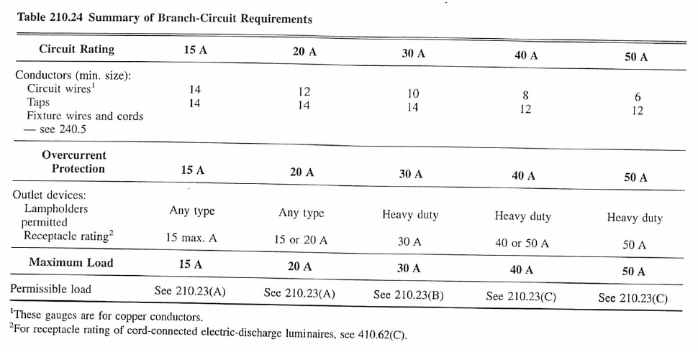
Ampacity
Finding wire gauge necessary, depends on situation.
Minimum is set by table 210.24:

Slide 3
Detailed calc comes starts with either Table 310.15(B)(16) for <=3 current carrying wires in a raceway or 310.15(B)(17) for 1 wire. In practice you will care about THHN, THWN, or USE2.

Slide 4
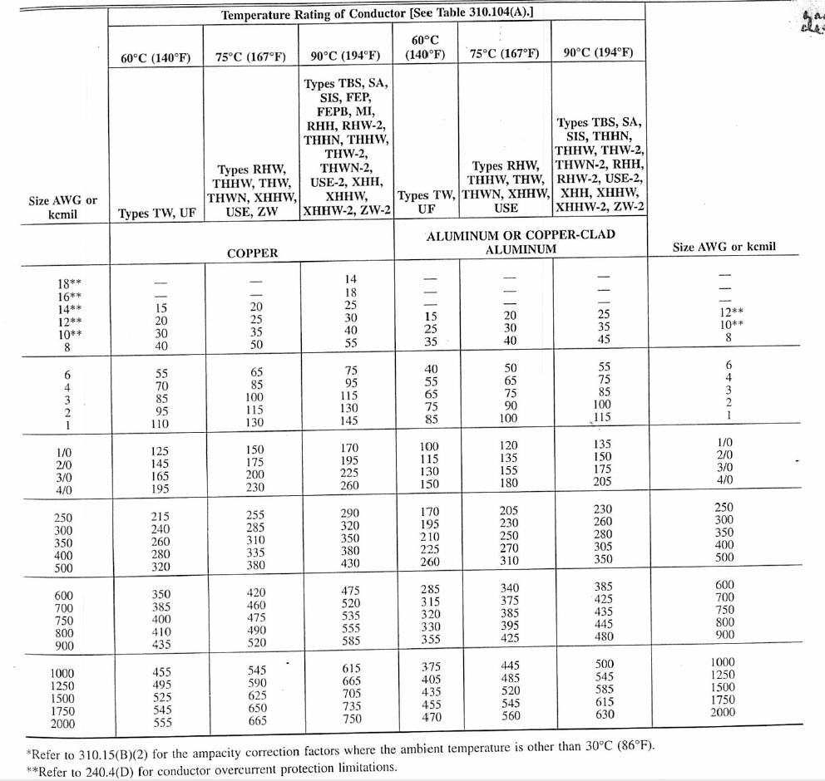
310.15 (B)(16) for <=3 current carrying wires

Slide 5
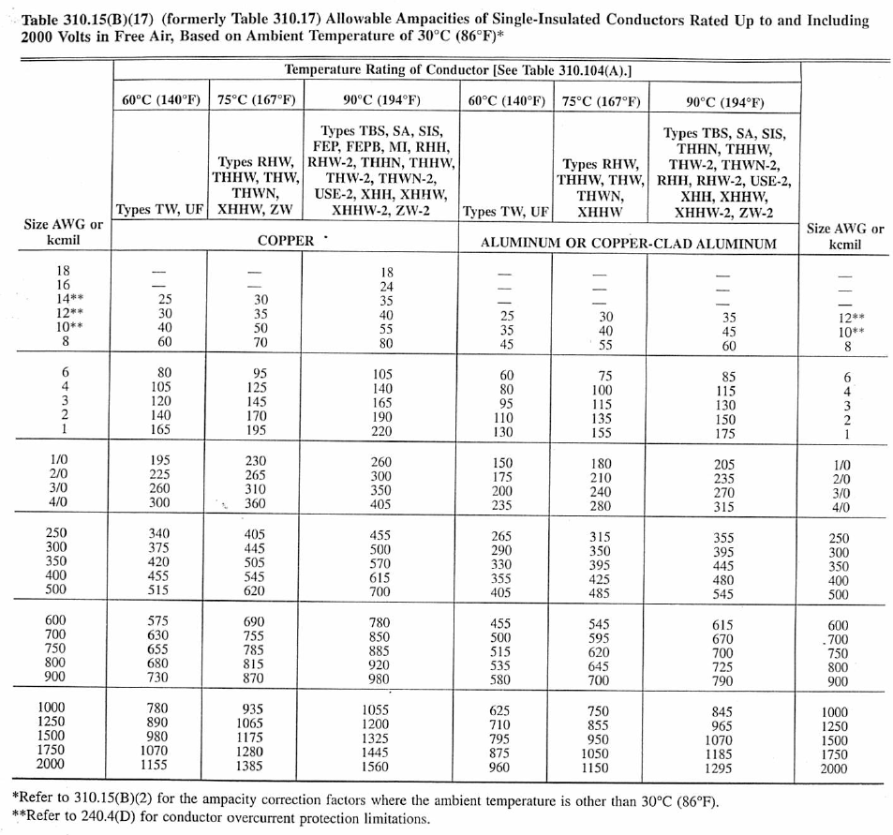
310.15 (B)(17) for 1 current carrying wire

Slide 6
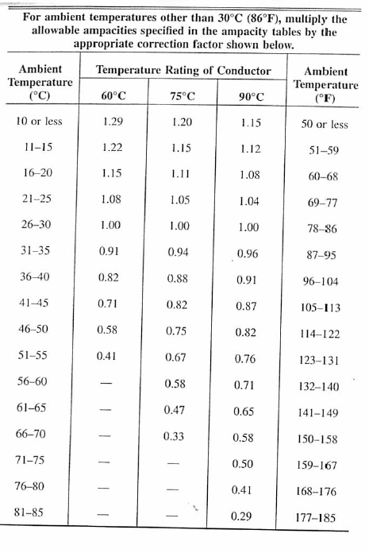
This is mediated by temperature
[from 310.15(B)(2)(a)]

Slide 7
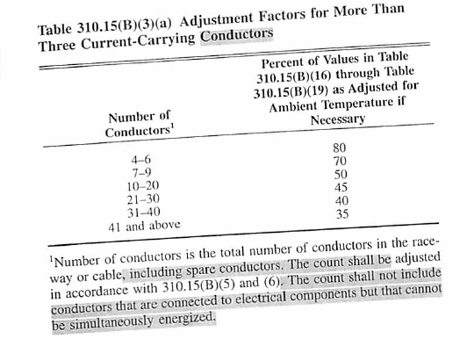
Number of conductors in a raceway [from Table 310.15(B)(3)a)]

Slide 8
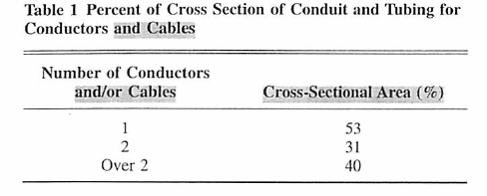
Raceway packing
[chapter 9 table 1]

Slide 9
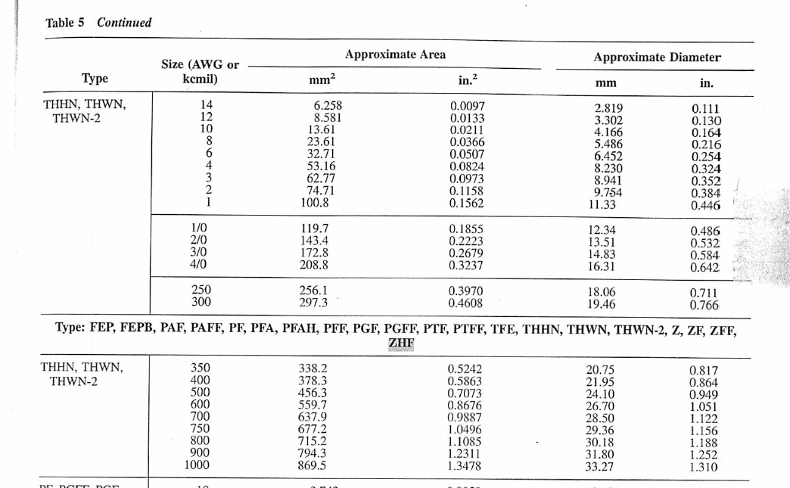
Raceways-Insulated conductors sizes
[Chapter 9 table 5]

