Slide 1
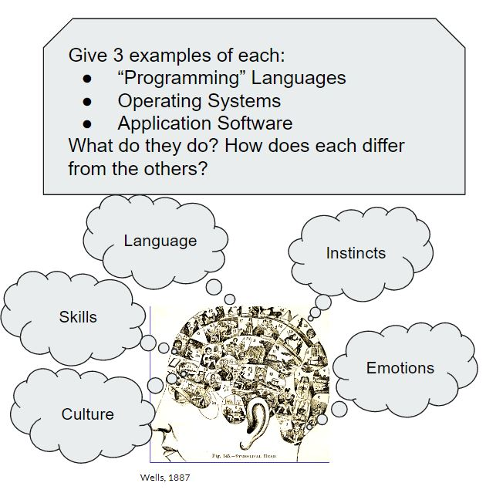
In-tracting From Theory
Gamifying teaching of concepts to connect with your student-audience
By: Xander Jackson, MLS

Slide 2
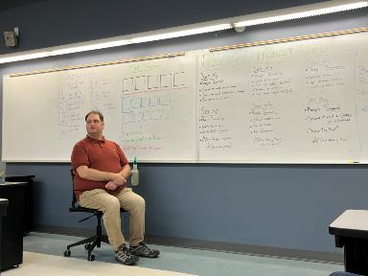
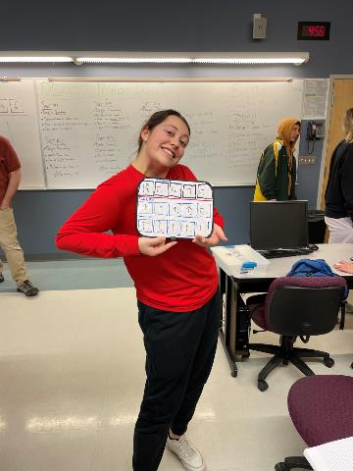
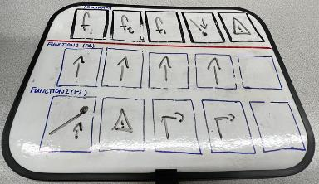
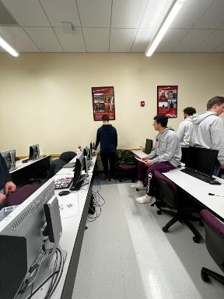
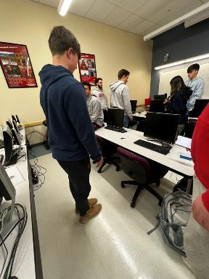
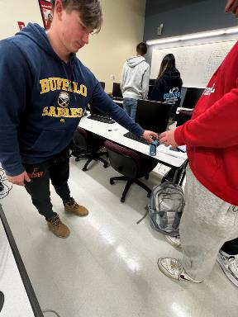
The Demonstration
Symbols to make a program
5 operations on top
2 Functions to call
5 ops each func
Compete to see who can:
Use least steps
Do action most times
Get stuck in a loop!

Slide 3
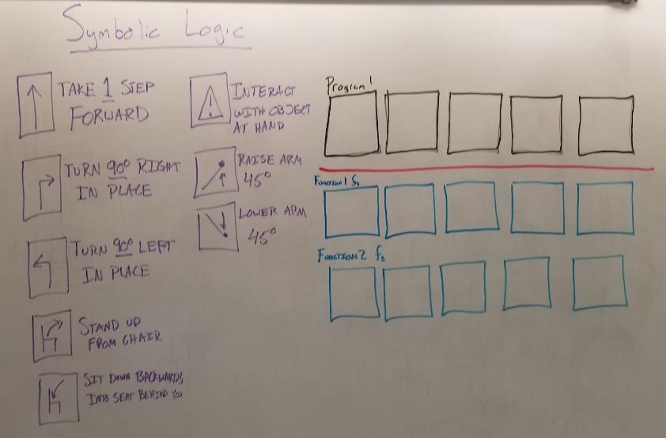
Operations
Your Task:
Use these commands
Make a Program
Be efficient
Compete to see which side can get the trophy

